Slide 1
Heavy Hitters Animation Snippets.
Neelmay Desai
Sairama Rachakonda
Nilay Chakraborty

Slide 2
Project Goal
There are many algorithmic animations available online for the algorithms which deal with problems where the size of data fits in the RAM or in the local disk. For example algorithm for sorting, comparing, finding median, finding frequent items on a small data set.
But in our algorithmic animations, we show an algorithm for processing large data streams that can be examined only in few passes generally only once per item and find the frequent words occurring above a threshold value. Another limitation for these algorithms is that the memory available for computation is less than their size.

Slide 3
Outline of Presentation
The presentation walks you through the description of the algorithm that is used to animate one of the methods of finding the frequent items above a threshold value in a streaming environment.
The presentation provides the user interfaces
The project stumbling blocks.
Future possible work.

Slide 4
Description
The main aim of the project is to animate and depict “How to find the frequent words which are above certain threshold value, in a streaming data and what value can the user get from such an information”.
We have algorithms which can find an object, which has occurred the most number of times in a stream of data. One such algorithm is the Misra Gries algorithm which finds the Majority element in a stream of data.
We have modified this algorithm in such a way that, the algorithm returns all frequent objects whose frequency is above the threshold value.

Slide 5
Algorithm 1: k Frequencey Estimator, Misra Gries Algo- rithm
Input: A stream σ = ⟨a1, a2..., an⟩
of length m where each ai ∈ [n]
and a frequency parameter k
Output: a data structure A, such that for any j ∈ [n], we can return A[j]= fj suchthatfj > m/k
Initialize: A ← (empty associative array) Process:j
if j ∈ A(keys)A[j] ← A[j] + 1
else if number of keys of A greater than k-1 then
A[k] ← 1; else
for every l ∈ keys(A)
A[l] ← A[l] − 1;
if A[l]=0 remove l from A;
<number>

Slide 6
Three variants
The algorithm animator animates three variants:
1) Finding the words which are above a given threshold frequency.
2) Finding the Majority element seen until now.
3) Finding if a given word of interest by user occurs greater than a threshold frequency.

Slide 7
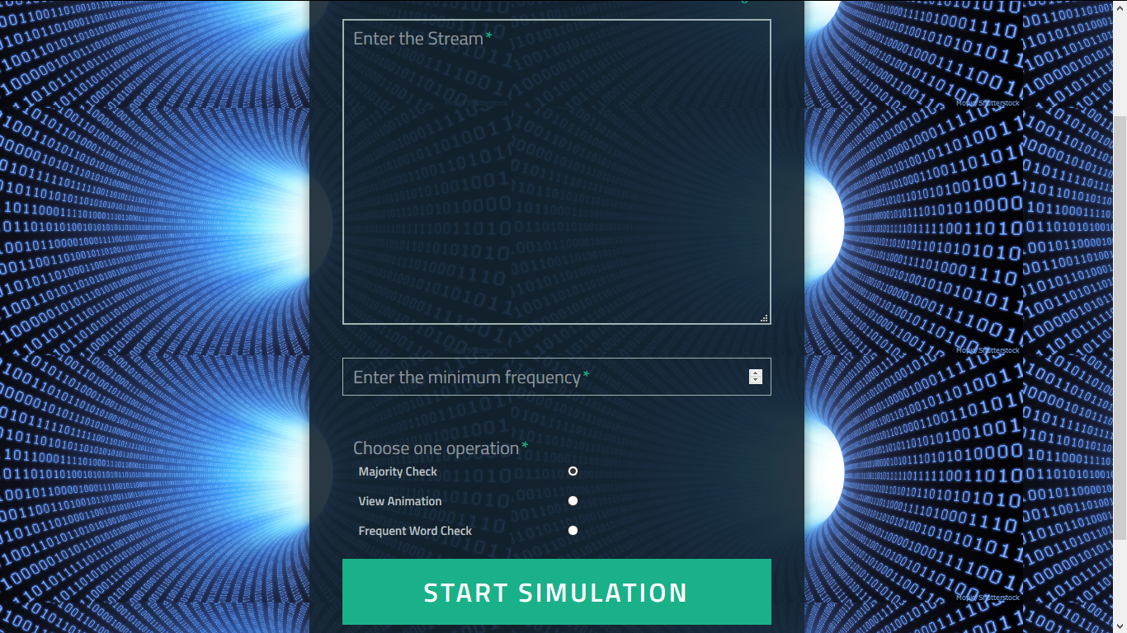
The user can enter the stream and the minimum frequency. User is provided with three options as shown.

Slide 8
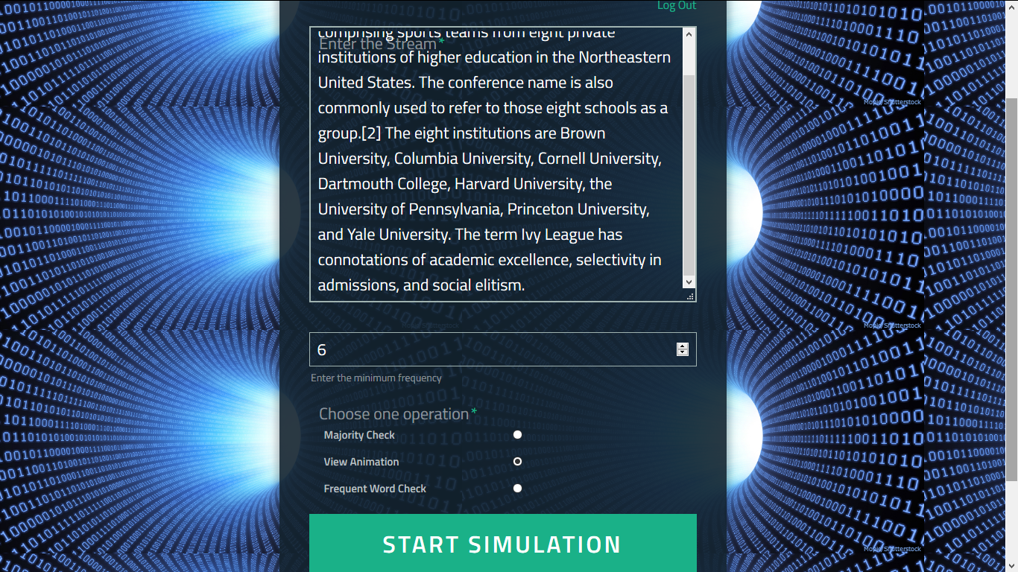
The user gives the stream and specifies the frequency.

Slide 9
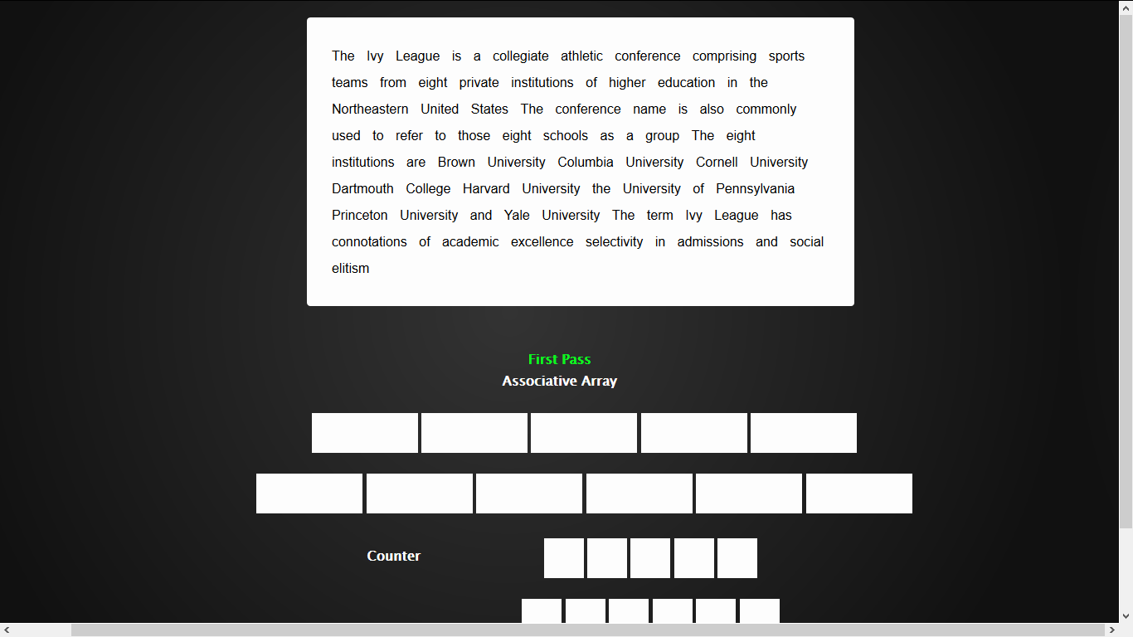
We use an associative array and a counter.

Slide 10
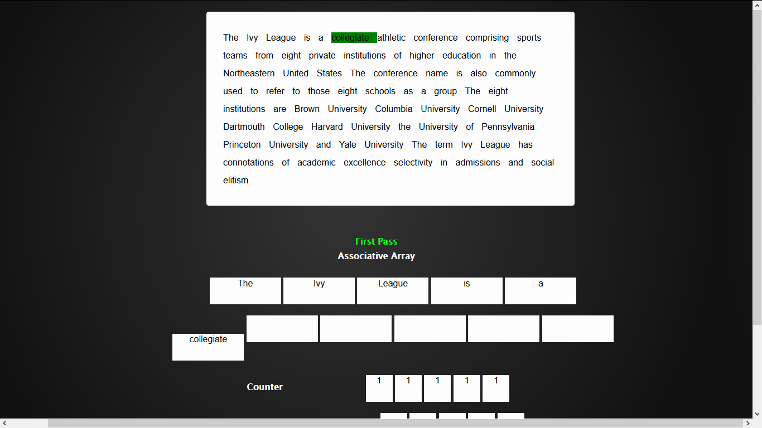
We go through each word in the batch of the stream. Use an associative array to store the string and a respective counter to store the count of the string.

Slide 11
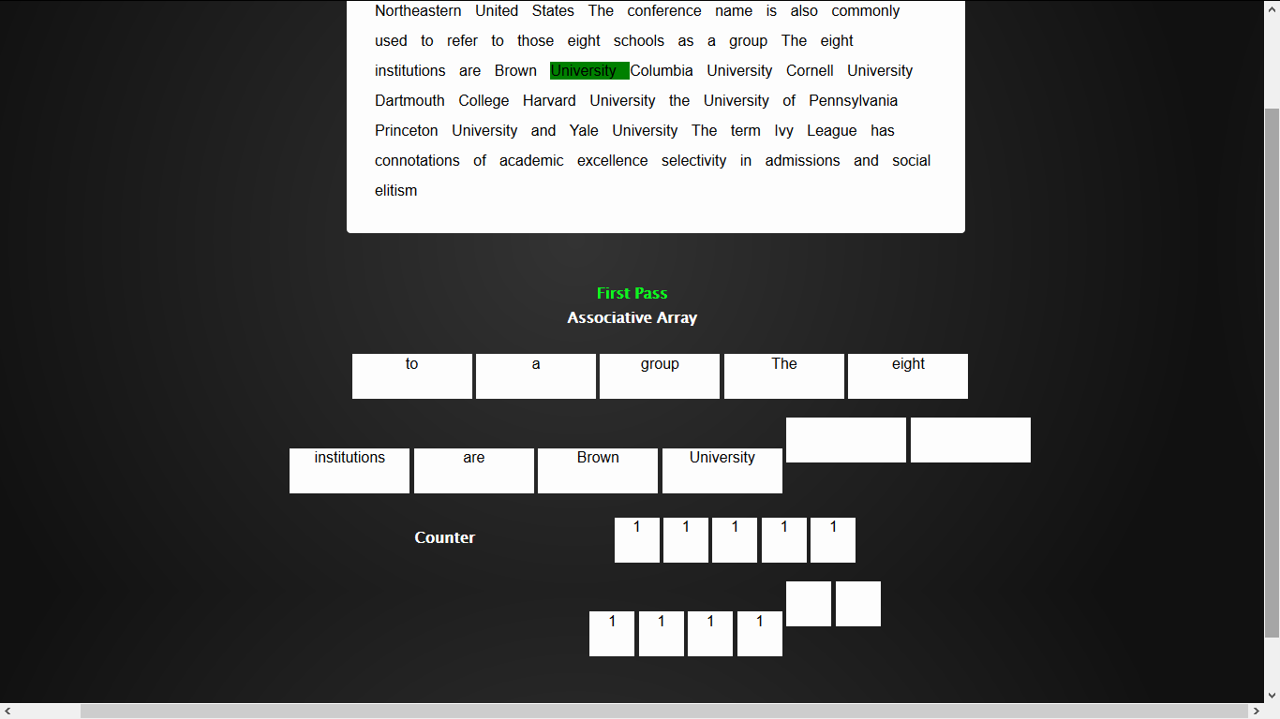

Slide 12
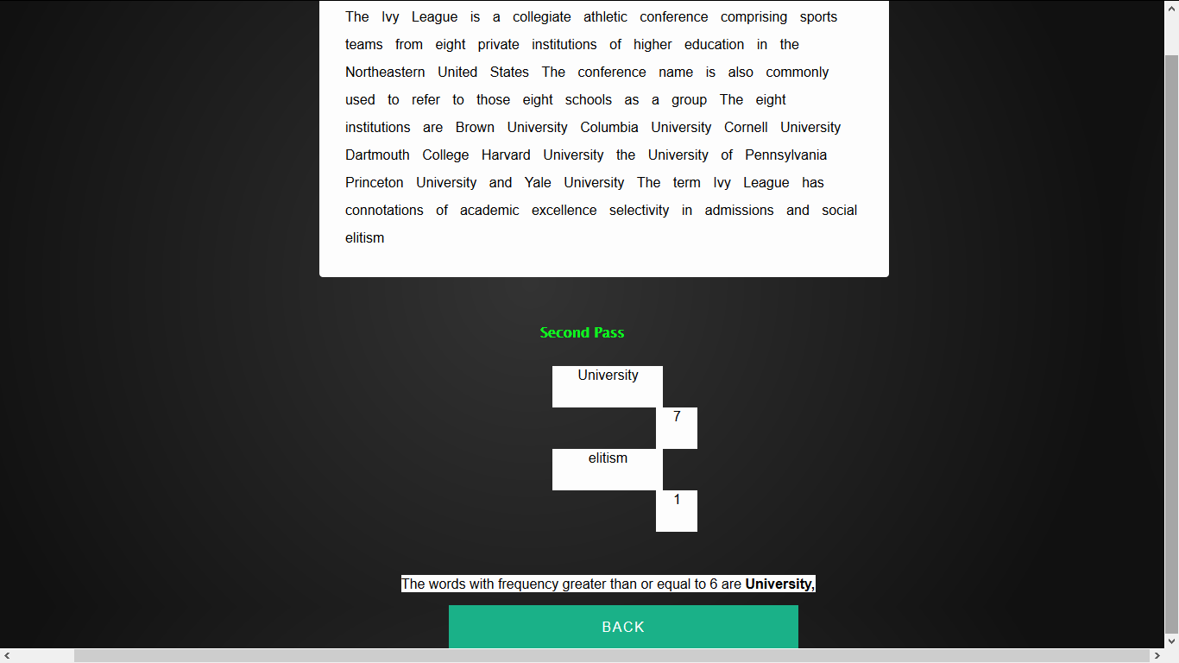
We perform a second pass on the batch of the stream, using the resulted associative array after the first pass.

Slide 13
After the second pass, we get the word ‘University’ as the frequent word with threshold greater than 6.

Slide 14
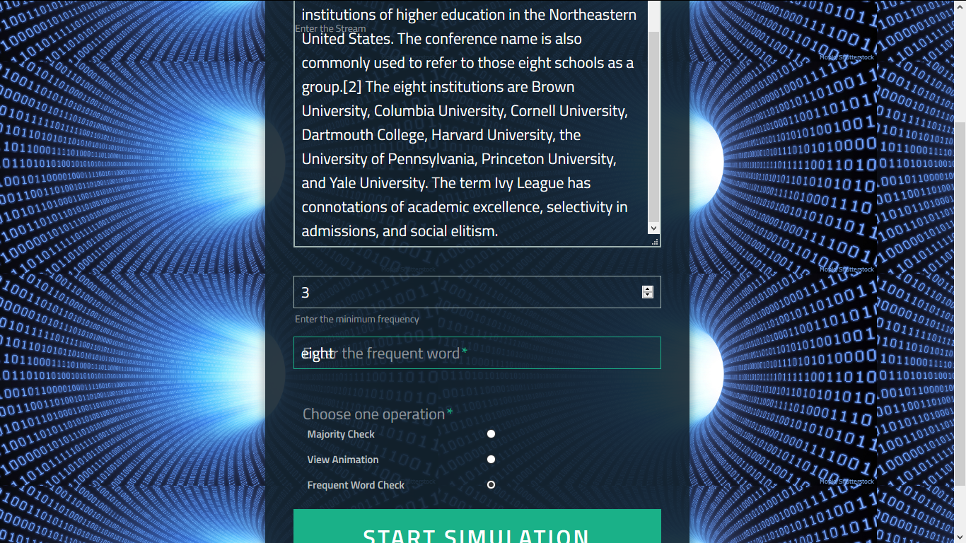
Querying the stream on given word and frequency.

Slide 15
The user queries the stream for the occurrence of a word above a given threshold frequency.

Slide 16
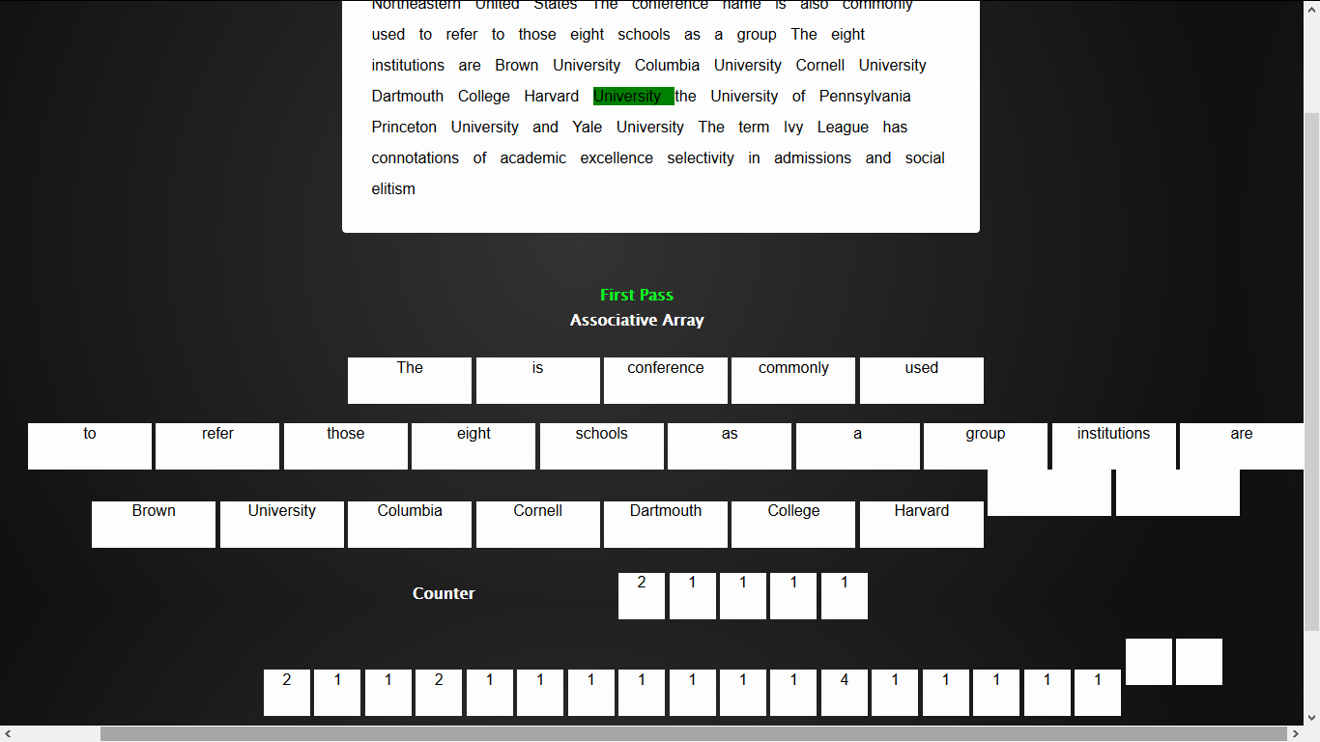

Slide 17
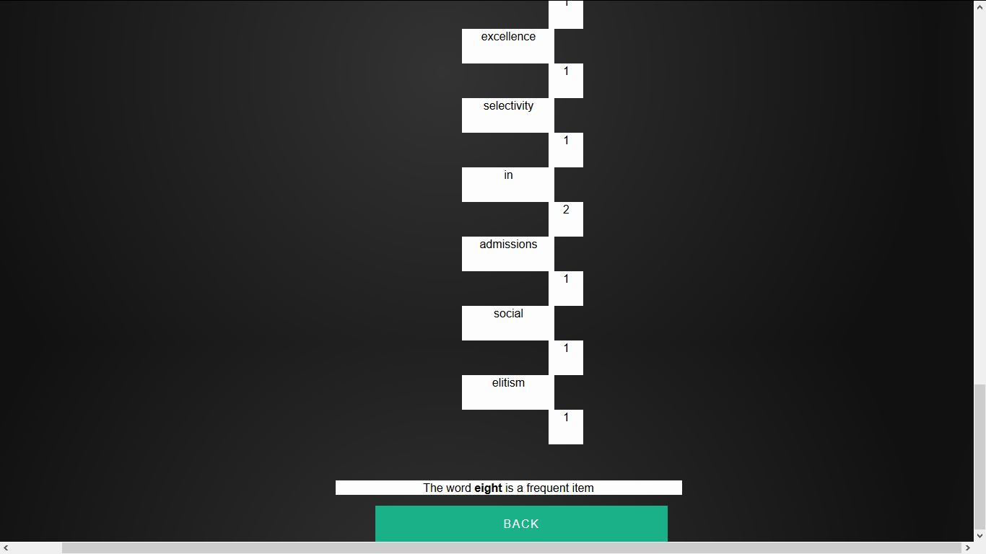

Slide 18
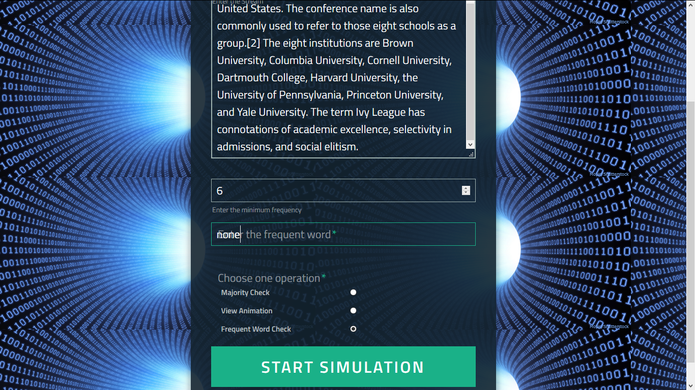

Slide 19
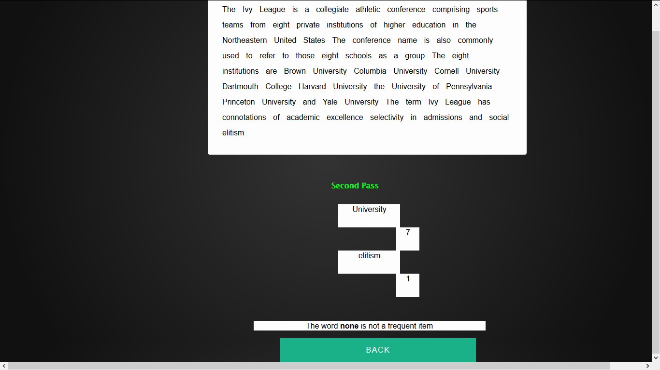

Slide 20
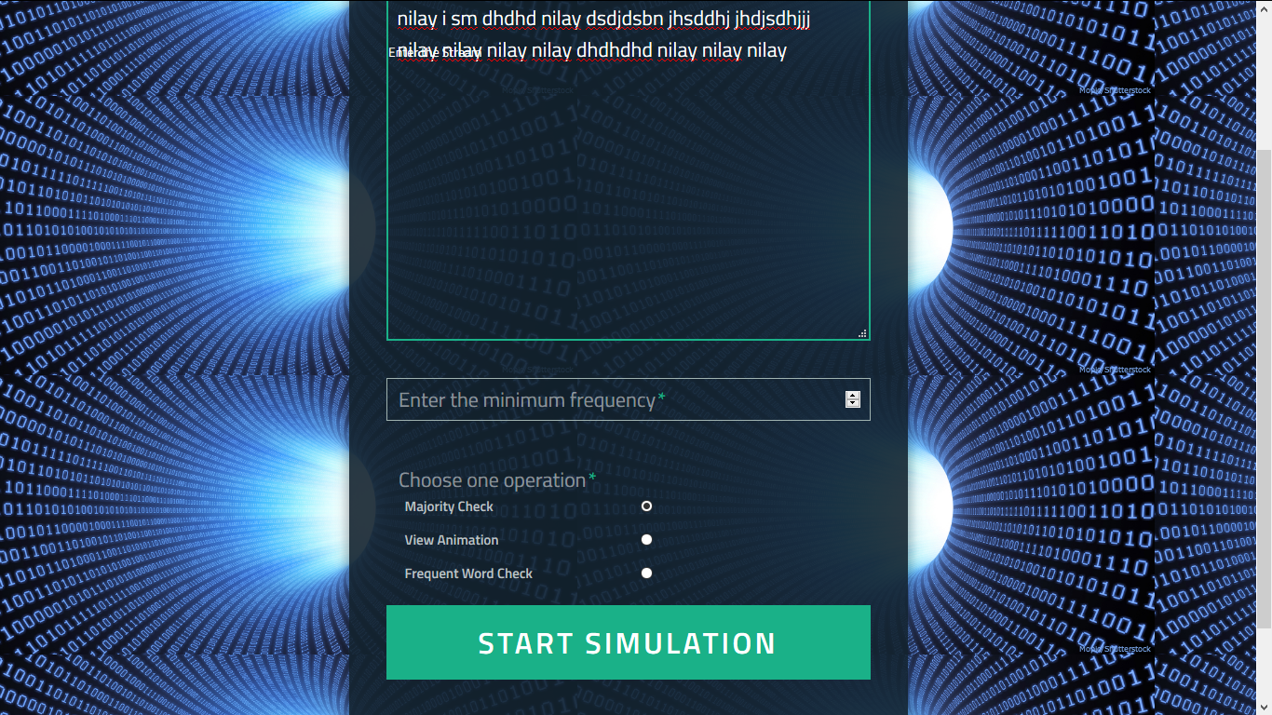
Finding the majority element.

Slide 21
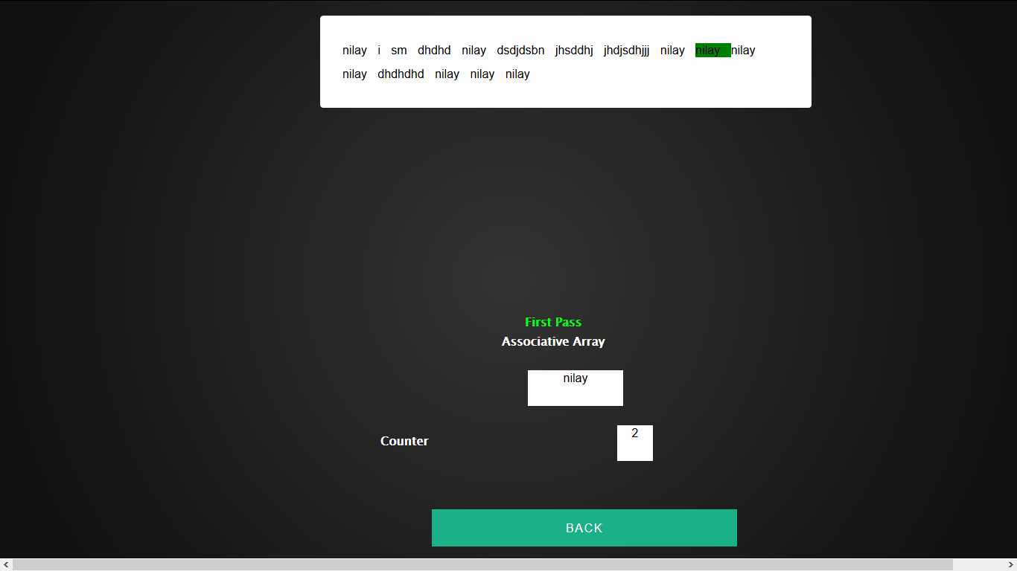
.

Slide 22
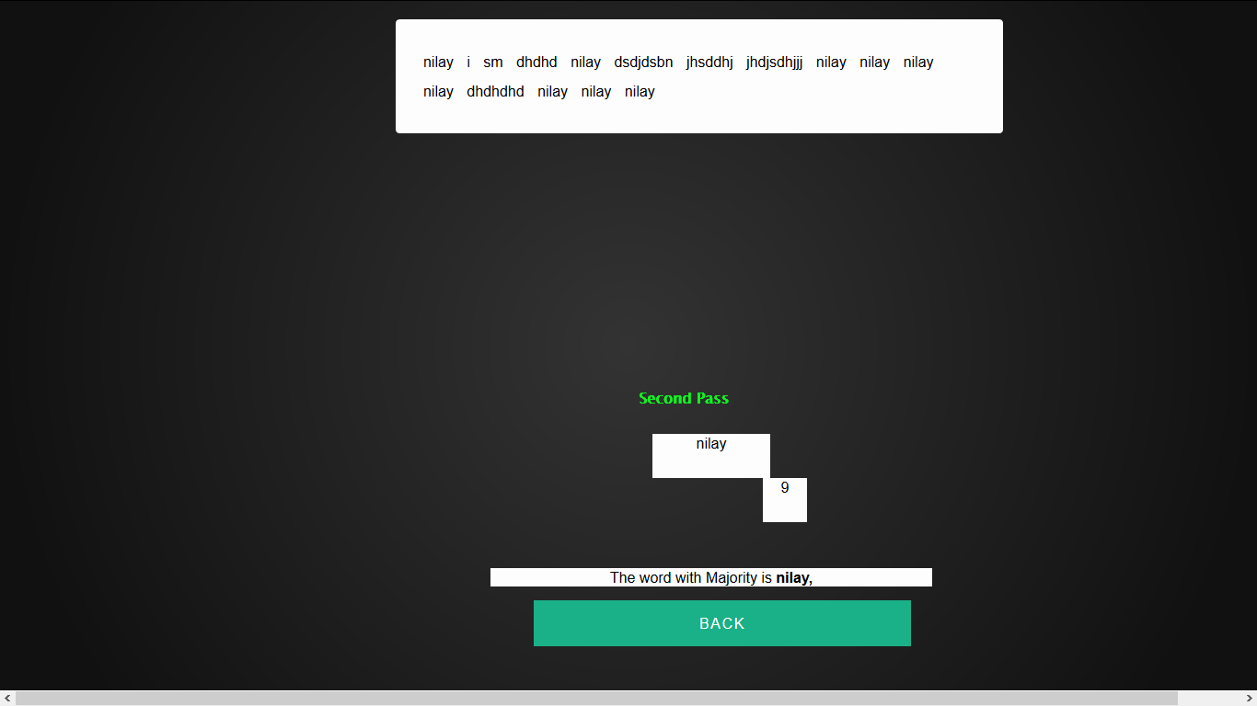

Slide 23
Project Stumbling blocks.
Extension of the algorithm to animate each step.
We had to replace the ‘for’ loop in the algorithm with set interval, so that we can fetch the changes in each iteration and display that in the web page after some time delays.
Animation
Adjusting the style sheets, HTML properties, was one problem faced by us. We need to do a meticulous manual adjustment so that, the visual experience is better provided the user.

Slide 24
Integrity Constraints
Flow Diagram Major Constraints.
– Integrity Constraint 1
Input data size limitation: The application is basically a learning platform. So huge data stream can’t be supported. Our project shows the animation for a relatively comparable unit of the huge data sets.
– Integrity Constraint 2
Mandatory Value Constraint: The application should be provided with a data stream. Either the user may provide a data stream or he can choose the admin to provide the data stream to visualize the algorithm.
The data stream is mandatory. – Integrity Constraint 3
Frozen Value Constraint: Once a data stream is provided to the algorithm, it can’t be changed until,the user resets the application to run for a new data stream. While the visualization is running, the user can’t change the data stream. He needs to reset the application.
C. Stage3 - The Implementation Stage.
Specification regarding the languages and programming environment used for the implementation are as below:
1) The User Login page is designed using MVC architecture.
• View- HTML/CSS
• Controller/Model - Java
• Backend - Oracle 12c
• ORM Framework - Hibernate
2) The algorithm animation snippet is implemented using Javascript, HTML and CSS.
3) The server used is Apache Tom Cat
4) IDE used is Eclipse Mars and SQL Developer..
The deliverables for this stage include the following items:

Slide 25
Integrity Constraints
Input Data Size Limitation:
The application is basically a learning platform. So huge data stream can’t be supported. Our project shows the animation for a relatively comparable unit of the huge data sets
Mandatory Value constraint:
The application should be provided with a data stream. Either the user may provide a data stream or he can choose the admin to provide the data stream to visualize the algorithm.
Frozen Value Constraint:
Once a data stream is provided to the algorithm, it can’t be changed until,the user resets the application to run for a new data stream. While the visualization is running, the user can’t change the data stream. He needs to reset the application.

Slide 26
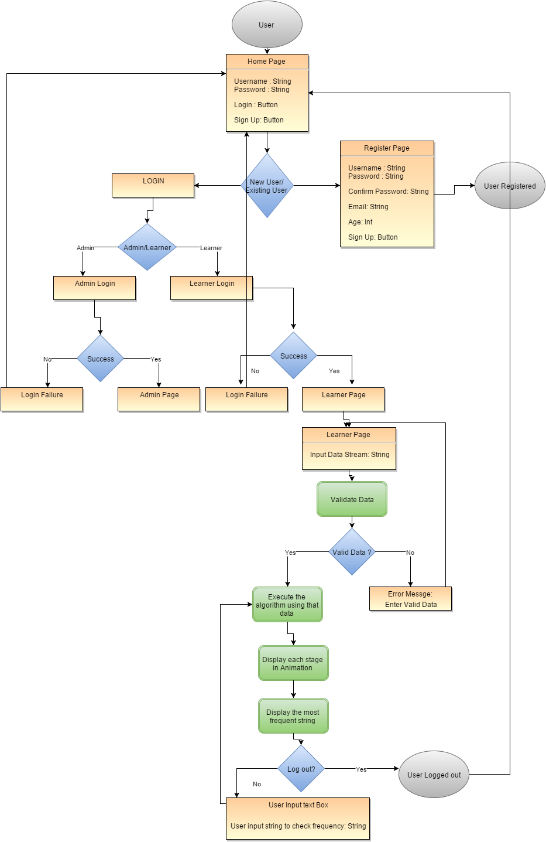
Data Flow Diagram

Slide 27
Future Extensions
Instead of finding words whose frequency is above a given threshold level, we can find pairs of words, whose frequency is greater than a given threshold. Also, we can plot a graph, with these pair of words as an edge and perform few statistics on the graph, to get a finer idea of words which occur more together in a text.

Slide 28
Contributions
Neelmay: System design, Modeling, back-end implementation, Management, Testing and Documentation
Santhosh: Requirement gathering & analysis, UI design
& implementation and Maintenance
Nilay: Animation Design, Middleware implementation and Deployment

Slide 29
References and Resources used.
http://dmac.rutgers.edu/Workshops/WGUnifyingTheory/Slides/cormode.pdf
http://utexas.influuent.utsystem.edu/en/publications/finding-repeated-elements(6ac4aeb3-8630-4aed-907b-23120087b927).html

